Slide 1

Word and Excel Integration
DYNAMICS CRM 2016

Slide 2

Mitch Milam
Dynamics CRM Architect
Independent consultant and trainer
Ten-Time Dynamics CRM MVP
mitch@xrmcoaches.com
infinite–x.net
@mitchmilam
http://tinyurl.com/MitchMilamLinkedIn

Slide 3
Future Events
Webinar: The 5 Top Dynamics CRM Ribbon Customizations
Friday, July 22th, 10:00am Central Time (U.S.) (GMT-5:00)
In this webinar we will walk through the top 5 ribbon customization activities with Dynamics CRM and walk through using the Ribbon Workbench.
Dynamics CRM Upgrade Strategies Deep Dive
Tuesday, July 26th, 2016 at 1:00pm Central Time (U.S.) (GMT-5:00)
In this workshop we will be discussing all aspects of upgrading your Dynamics CRM system from version 4.0 onward.
Registration ends today!
Webinar: Introduction to Dynamics CRM Project Service Automation
Friday, Jul 29, 2016 10:00 AM Central Time (U.S.) (GMT-5:00)
In this webinar we will review the installation and configuration of the new Project Service Automation feature available for Dynamics CRM Online (Spring Release).

Slide 4
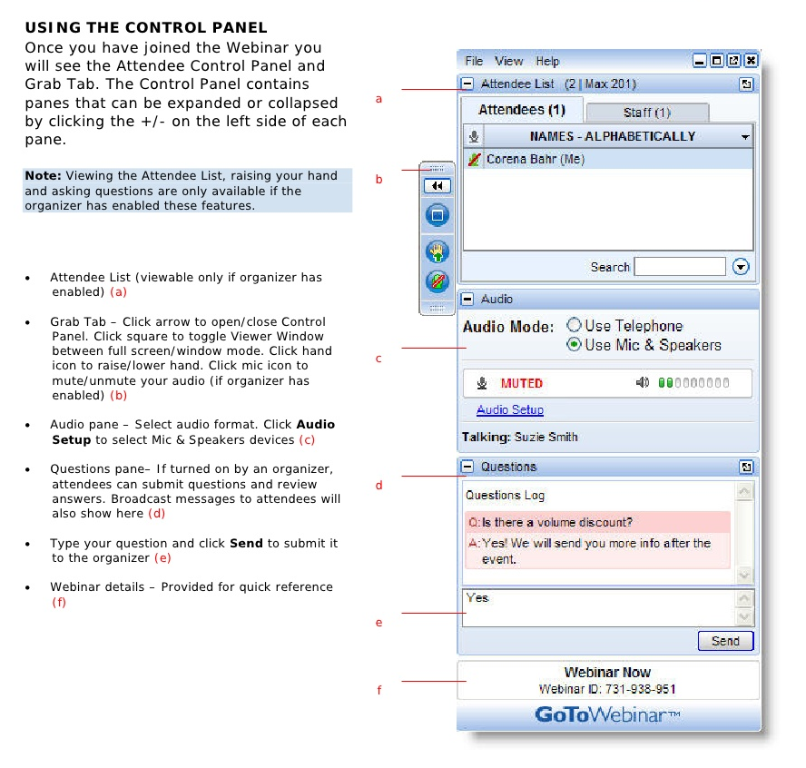
Webinar Housekeeping

Slide 5



2016 Training Roadmap
Webinars
http://www.xrmcoaches.com/webinars
KnowledgeBits
http://www.xrmcoaches.com/knowledgebits
Learning Plans
http://www.xrmcoaches.com/freestuff
More Goodies
Practice tests
On–Demand video training
Instructor–led training
Books

Slide 6
Agenda
Word Integration Overview
Excel Integration Overview
Third-Party Solutions
Demonstrations

Slide 7
Overview

Slide 8
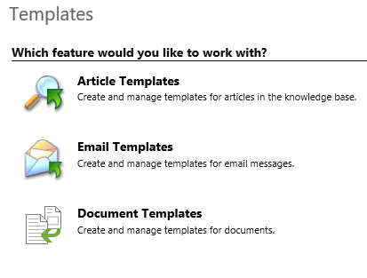
System Document Templates

Slide 9
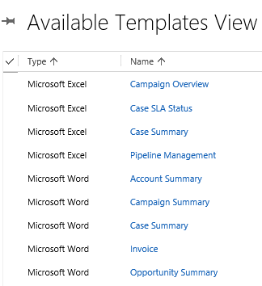
Available System Templates

Slide 10
Functionality
You may:
Create a new template from scratch
Upload an existing file as a template
Delete an existing template
Templates must be activated (like Processes) before being available for use

Slide 11
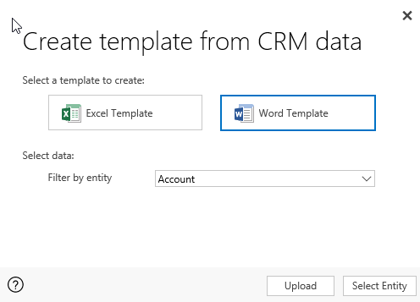
Creating a New Template

Slide 12
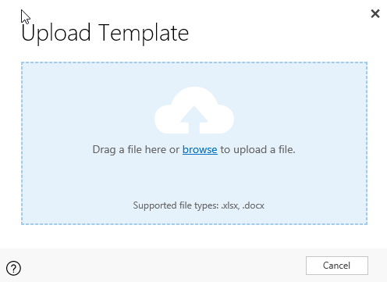
Upload Template

Slide 13
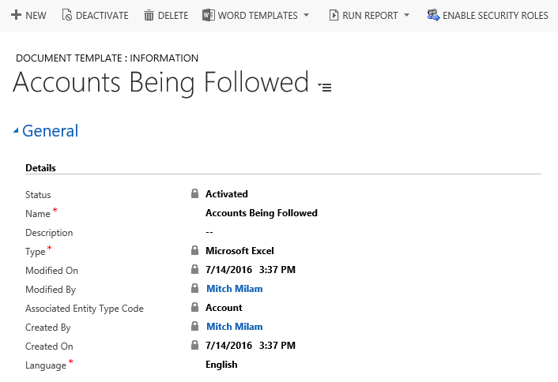
Uploaded Template

Slide 14
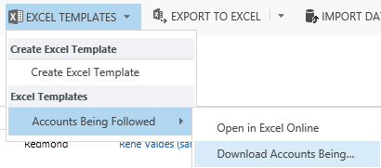
Using a Template

Slide 15
Security

Slide 16
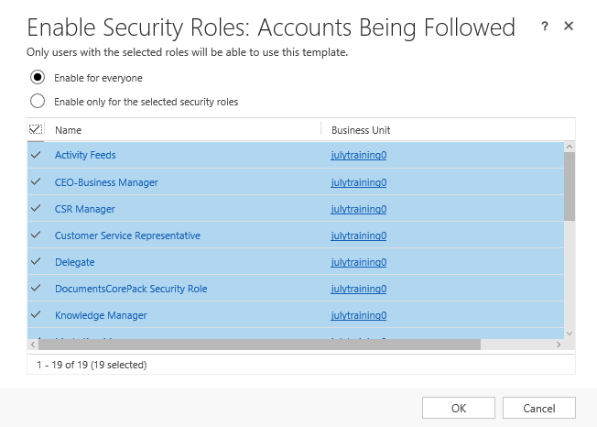
Security Roles

Slide 17
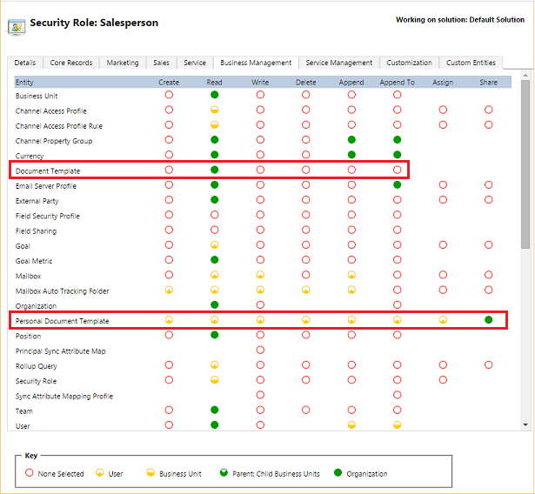
Security Role Privileges

Slide 18
Word Integration Overview

Slide 19
Microsoft Word Support
The following are the supported versions of Word
Area | Word Version
Creating a Word template | 2013, 2016
Using a Word document generated in CRM | 2010, 2013, 2016

Slide 20
Creating a New Word Template

Slide 21
Word Template Features
Works on a single record
Clicking Download File creates and downloads the template

Slide 22
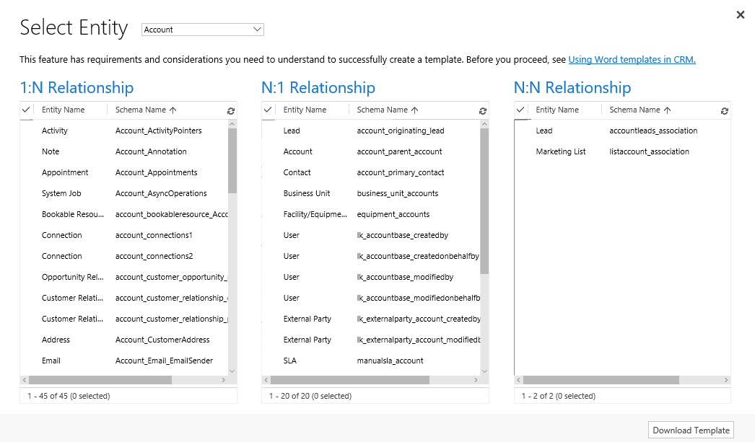
Relationship Selection

Slide 23
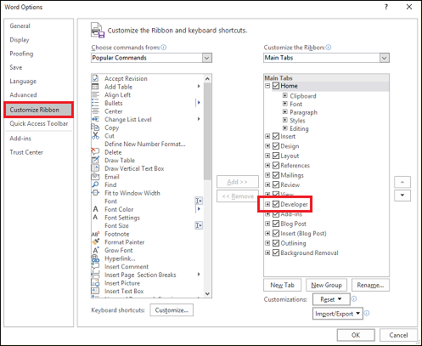
Enable the Developer Tab

Slide 24
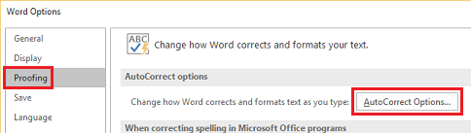
Turn Off AutoCorrect

Slide 25
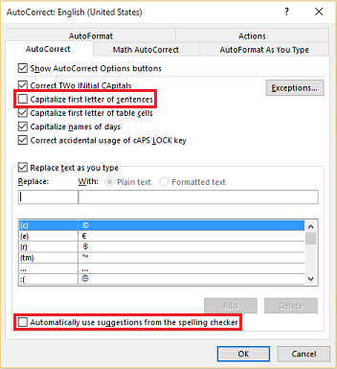
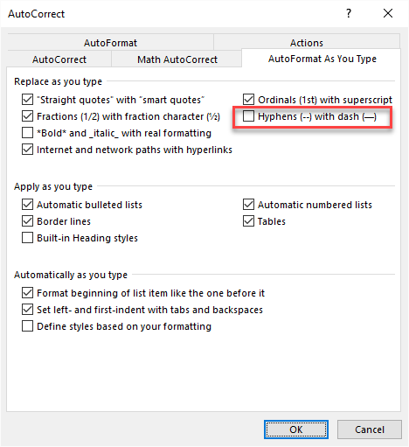
Turn Off AutoCorrect Options

Slide 26
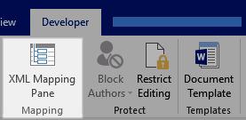
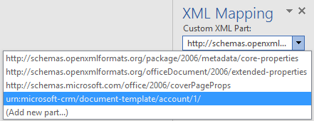
XML Mapping Pane

Slide 27
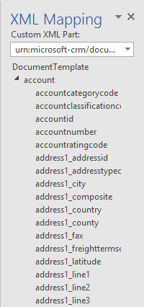
XML Mapping Pane

Slide 28
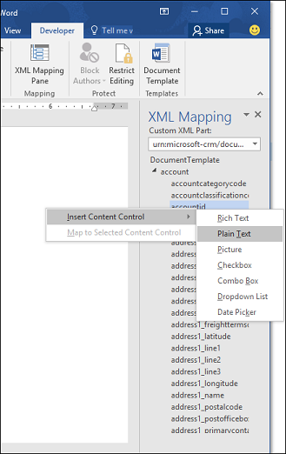
Inserting Fields
Only use
Plain Text
Picture

Slide 29
Excel Integration Overview

Slide 30
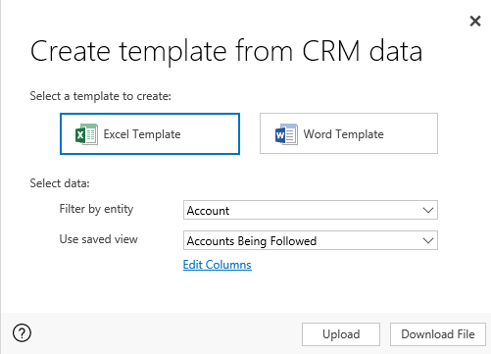
Creating a New Excel Template

Slide 31
Excel Template Features
System views only
You may select the columns to export
Only entity fields may be exported
Clicking Download File creates and downloads the template

Slide 32
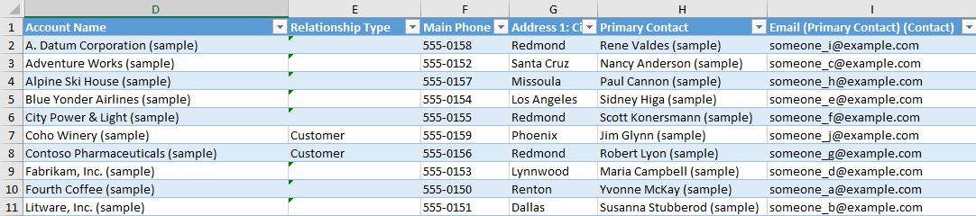
Sample Excel Template

Slide 33
Data Re-Import
You may re-import the data from a template-generated Excel template if you do not change the worksheet layout
Rows and columns only
Do not modify columns A-C
Do not create a pivot table
Standard re-import rules apply

Slide 34
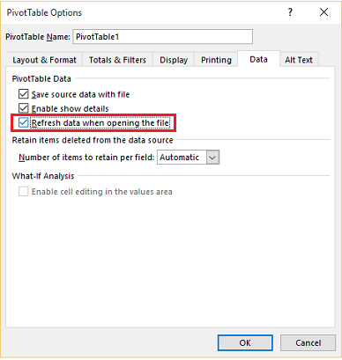
Pivot Table Options

Slide 35
Notes

Slide 36
General Notes
You cannot have the template being uploaded open in either Word of Excel
New templates may not display after being uploaded. You will need to reload the CRM page to see them
Name your working template differently than your generated template so they do not get overwritten

Slide 37
Interesting Usages
Document templates can take the place of SSRS reports.
Can be used within Dynamics CRM mobile

Slide 38
Personal vs. System Templates
System Templates
Uploaded into the Settings, Templates, Document Templates area
Personal Templates
Uploaded from an entity view or form

Slide 39
Additional Functionality

Slide 40
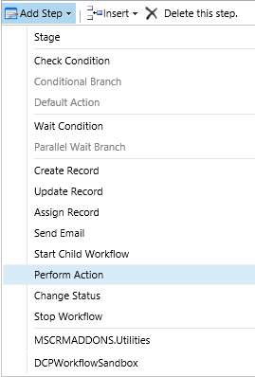

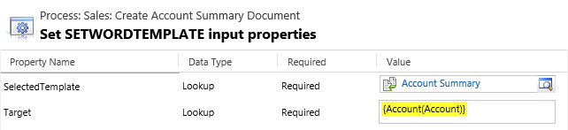
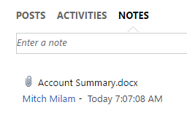
Automation (Workflow)

Slide 41
Third-Party Solutions

Slide 42
Third-Party Solutions
XperiDo for Microsoft Dynamics CRM
http://www.xperido.com/products/xperido-microsoft-dynamics-crm
DocumentsCorePack
http://www.mscrm-addons.com/Products/DocumentsCorePack
Xpertdoc CRM Connector
https://www.xpertdoc.com/en/xpertdoc-crm-connector
PandaDoc
https://www.pandadoc.com/faqs/msdynamics-integration-pandadoc
Document Generator
http://crmbricks.com/en/products/dynamics-crm-2015-addons/document-generator
Dynamics Docs
http://www.dynamicsobjects.com/Products/Dynamics-Docs

Slide 43
Demonstrations

Slide 44
Questions?

Slide 45
Thank You

